Slide 1

Aroma: Code Recommendation via Structural Code Search

Slide 2
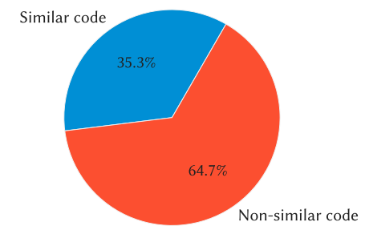
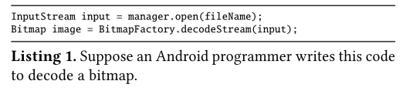
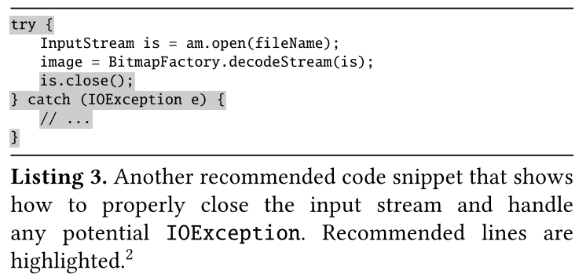
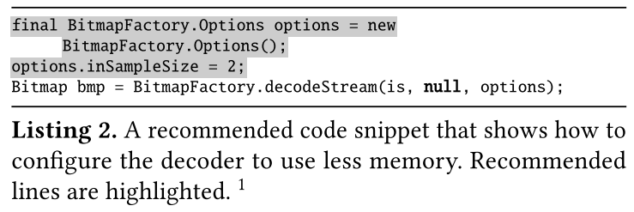
Introduction
Programmers often write code that has similarity to existing code written somewhere.
A tool that could help programmers to search such similar code would be immensely useful.
extend partially written code snippets to completely implement necessary functionality
discover extensions to the partial code which are commonly included by other programmers
add extra code which would fix common mistakes and errors

Slide 3
Introduction
Existing techniques
Code-to-code search tools [Kim et al. 2018; Krugler 2013]
Retrieve relevant code snippets from a corpus using a partial code snippet as query.
return lots of relevant code snippets without removing or aggregating similar-looking ones.
do not make any effort to carve out common and concise code snippets from similar-looking retrieved code snippets.
Pattern-based code completion tools [Mover et al. 2018; Nguyen et al. 2012, 2009]
Mine common API usage patterns from a large corpus and use those patterns to recommend code completion for partially written programs as long as the partial program matches a prefix of a mined pattern.
cannot recommend any code outside the mined patterns—the number of mined patterns are usually limited to a few hundreds.
Code clone detectors [Cordy and Roy 2011; Jiang et al. 2007; Kamiya et al. 2002; Sajnani et al. 2016]
usually retrieve code snippets that are almost identical to a query snippet.
may not always contain extra code which could be used to extend the query snippet.

Slide 4
Introduction
Aroma, a code recommendation engine:
Given a code snippet as input query and a large corpus of code containing millions of methods, Aroma returns a set of recommended code snippets such that each recommended code snippet:
contains the query snippet approximately
is contained approximately in a non-empty set of method bodies in the corpus.
any two recommended code snippets are not quite similar to each other.

Slide 5
Introduction
Aroma, a code recommendation engine:
Indexes the given corpus of code.
Searches for a small set (e.g. 1000) of method bodies which contain the query code snippet approximately.
Prunes the retrieved snippets so that the resulting pruned snippets become similar to the query snippet
Ranks the retrieved code snippets based on the similarity of the pruned snippets to the query snippet.
Clusters the snippets so that similar snippets fall under the same cluster.
Intersects the snippets in each cluster to carve out a maximal code snippet which is common to all the snippets in the cluster and which contains the query snippet.
Notes:
challenge in designing this search step is that a query snippet, unlike a natural language query, has structure, which should be taken into account while searching for code

Slide 6
Introduction
Advantages of Aroma
A code snippet recommended by Aroma does not simply come from a single method body, but is generated from several similar-looking code snippets via intersection.
Aroma does not require mining common coding patterns or idioms ahead of time. Therefore, Aroma is not limited to a set of mined patterns.
Aroma is fast enough to use in real time. A key innovation in Aroma is that it first retrieves a small set of snippets based on approximate search, and then performs the heavy-duty pruning and clustering operations on this set.
Aroma is easy to deploy for different programming languages because its core algorithm works on generic parse trees. We have implemented Aroma for Hack, Java, JavaScript and Python.
It could be used to also perform efficient and precise code-to-code structural search.

Slide 7
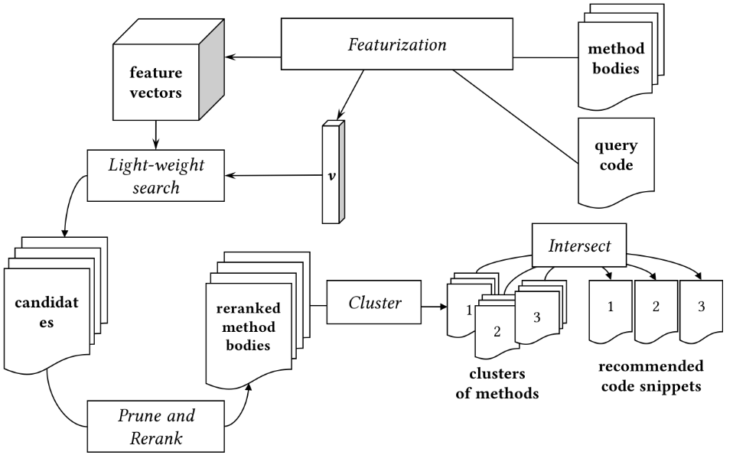
Algorithm
Aroma Code Recommendation Pipeline

Slide 8
Algorithm
Definitions
Definition 1 (Keyword tokens). The set of all tokens in a language whose values are fixed as part of the language, such as while, if, else, and symbols such as {, }, ., +, *.
Definition 2 (Non-keyword tokens). The set of all tokens that are not keyword tokens, such as variable names, method names, field names, and literals.
Definition 3 (Simplified Parse Tree). A simplified parse tree is a data structure we use to represent a program. It is recursively defined as a non-empty list whose elements could be any of the following:
a non-keyword token
a keyword token
a simplified parse tree.

Slide 9
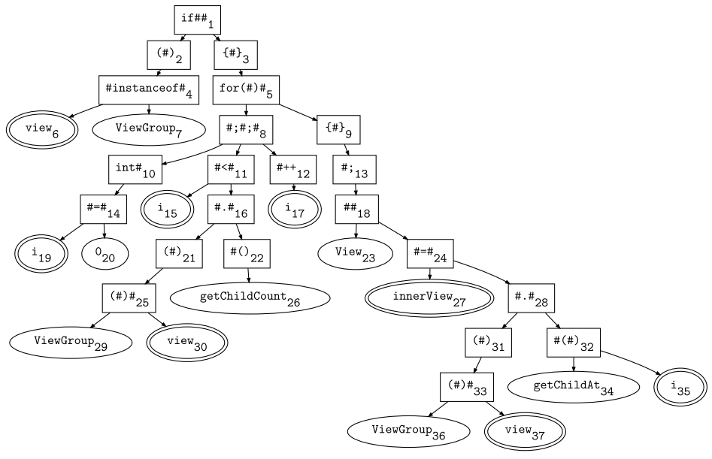
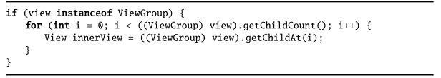
Algorithm
Definitions
Notes:
instead of conventional abstract syntax tree representation because the representation only consists of program tokens and does not use any special language-specific rule names such as If Statement, block, etc
can be used uniformly across various programming languages. Moreover, one could perform an in-order traversal of a simplified parse tree and print the token names to obtain the original program albeit unformatted.

Slide 10
Algorithm
Definitions
Given a simplified parse tree t, we use the following notations.
L(t) denotes the label of the tree t. E.g. L(if##1) = if##.
N(t) denotes the list of all non-keyword tokens present in t or in any of its sub-trees, in the same order as appearing in the source code. E.g. N(#.#28) = [ViewGroup36, view37, getChildAt34, i35].
P(n) denotes the parent of n. E.g. P(view6) = #instanceof#4.
if n2 appears after n1 in the program without any intervening non-keyword token, then we use Prev(n2) to denote n1 and Next(n1) to denote n2. E.g. Prev(view30) = ViewGroup29, Next(ViewGroup29) = view30.
if n1 and n2 are the two consecutive usages of the variable in the source code, then we use PrevUse(n2) to denote n1 and NextUse(n1) to denote n2. E.g. PrevUse(view30) = view6, NextUse(view30) = view37.
If n is a non-keyword token denoting a local variable and it is the i-th child of its parent t, then the context of n, denoted by C(n), is defined to be: (i, L(t)), if L(t) ≠ #.#. E.g. C(view30) = (2, (#)#).
Notes:
N(t): 该节点及其子树上的所有non-keyword
C(n): 哪个节点的第几个孩子

Slide 11
Algorithm
Featurization
Given a simplified parse tree, we extract four kinds of features for each non-keyword token n in the program represented by the tree:
Token Feature of the form n: If n is a local variable, then we replace n with the special token #VAR. we do not replace global variables and method names with #VAR. This is because such identifiers are often part of some library API and cannot be alpha-renamed to obtain equivalent programs.
Parent Features of the form (n, i1, L(t1)), (n, i2, L(t2)), and (n, i3, L(t3))
Sibling Features of the form (n, Next(n)) and (Prev(n),n)
Variable Usage Features of the form (C(PrevUse(n)), C(n)) and (C(n), C(NextUse(n)))
For a non-keyword token n ∈ N(t), we use F(n) to denote the multi-set of features extracted for n.
For a simplified parse tree t, we use F(t) to denote the multi-set of features of all non-keyword tokens in t, i.e. F(t) = F(N(t)).

Slide 12
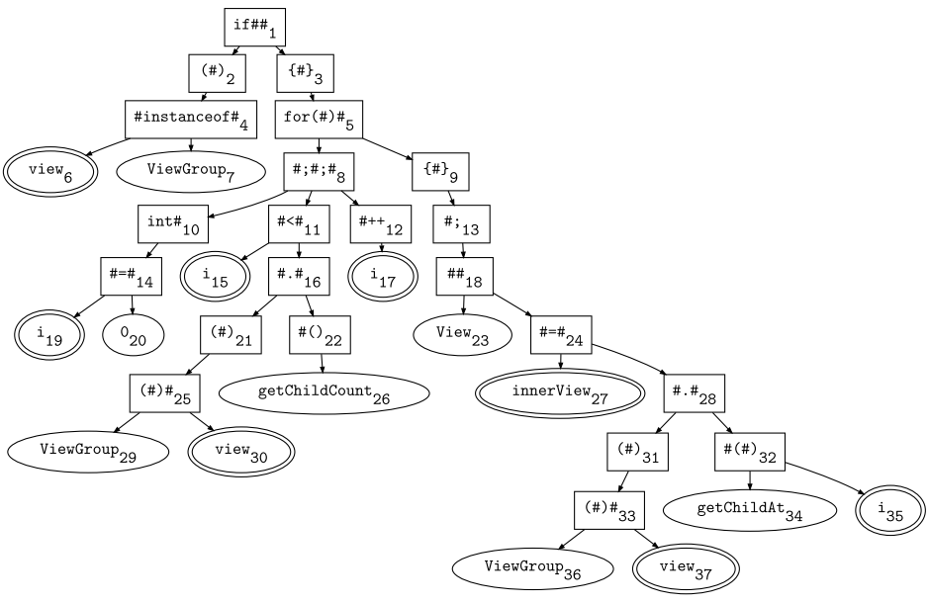
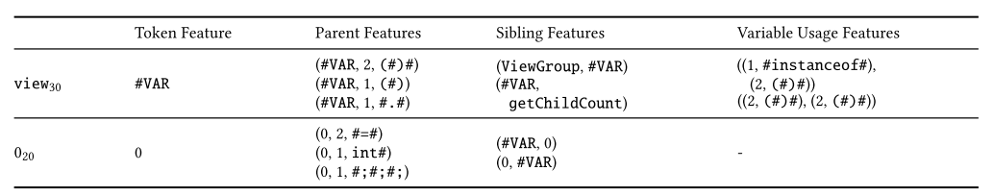
Algorithm
Featurization

Slide 13
Algorithm
Recommendation Algorithm
Phase I: Light-weight Search
In this phase, Aroma finds a list of method bodies that overlap with the query code snippet.
Aroma assumes that it is given a large corpus of programs containing millions of methods.
Aroma parses and creates a simplified parse tree for each method body, and then featurizes each simplified parse tree. M is the set of simplified parse trees of all method bodies in the corpus.
Aroma also parses the query code snippet to create the simplified parse tree, say q, and extracts its features.
For the simplified parse tree m of each method body in the corpus, we use the cardinality of the set S(F(m)) ∩S(F(q)) as an approximate score, called overlap score, of how much of the query code snippet overlaps with the method body.
Aroma computes a set of η1(1000) method bodies whose overlap scores are highest with respect to the query code snippet.
Notes:
特征重合数目

Slide 14
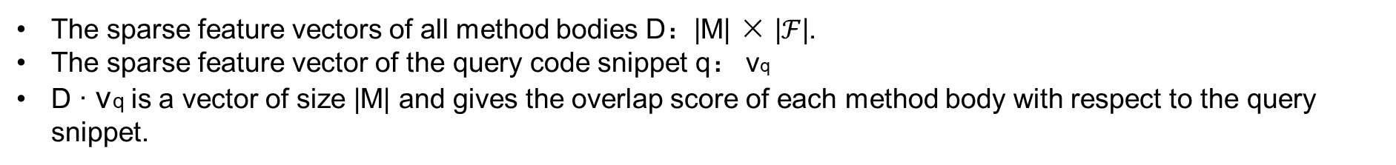
Algorithm
Recommendation Algorithm
Phase I: Light-weight Search
The computation of the list can be reduced to a simple multiplication between a matrix and a sparse vector.
The features of a code snippet can be represented as a sparse vector of length |$ℱ$|—the vector has an entry for each feature in $ℱ$, where $ℱ$ is the set of all features that can extracted from a given corpus of code.
The sparse feature vectors of all method bodies D：|M| × |$ℱ$|.
The sparse feature vector of the query code snippet q： vq
D · vq is a vector of size |M| and gives the overlap score of each method body with respect to the query snippet.
Aroma picks the top η1 (1000) method bodies with the highest overlap scores, and N1 is the set of simplified parse trees of the method bodies picked by Aroma.

Slide 15

Algorithm
Recommendation Algorithm
Phase II: Prune and Rerank
In this phase, Aroma reranks the code snippets from the previous phase using a containment score, which tells to what degree a query code snippet is contained in a code snippet.
Aroma prunes the simplified parse tree m of the method body, so that the similarity between the simplified parse tree of the query and the pruned tree m′, is maximized.
The similarity score between q and m′, denoted by Sim(q,m′), is defined as follows:
Aroma reranks the trees in N1 in descending order using the containment scores between the trees in N1 and q. Let N2 be the list of the trees after reranking.

Slide 16
Algorithm
Recommendation Algorithm
Phase III: Cluster and Intersect
From the list of method bodies N2 (i.e. the reranked search results), Aroma picks the top η2(100) methods with the highest containment scores that are also above a predefined threshold $τ$1(0.65).
Aroma then clusters the code snippets based on similarity and intersects the snippets in each cluster to get a concise code snippet for recommendation.
The clustering step is necessary to avoid showing recommendations that are similar to each other—for each cluster, only one code snippet is shown as recommendation.
Let N3 be the sorted list of the remaining clusters, Aroma picks the top K (5) tuples from N3 and returns the intersection of each tuple with the query code snippet as recommendations
Notes:
交叉算法的工作原理，是将第一个代码片段作为“基础”代码，而后针对集群当中的每一种其它方法以迭代方式对其进行剪枝。剪枝过程之后的剩余代码将成为所有方法中的共有代码，并成为代码建议中的组成部分

Slide 17
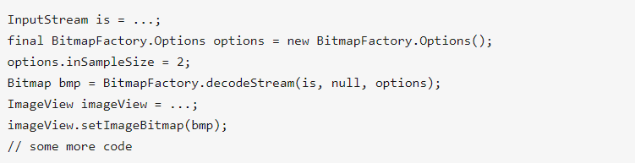
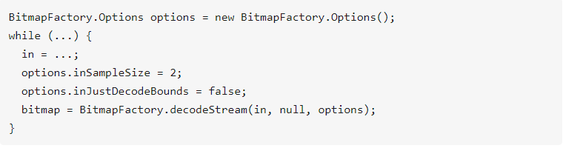
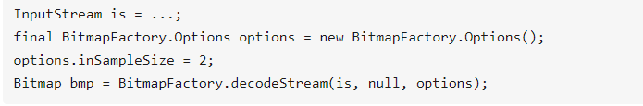
Algorithm
Recommendation Algorithm

Slide 18
Evaluation
Assess how Aroma code recommendation can be useful to programmers.
Datasets
5,417 GitHub projects where Java is the main language and Android is the project topic. We ensured the quality of the corpus by picking projects that are not forked from other projects, and have at least 5 stars
Remove duplicates at project level, file level, and method level. After removing duplicates, the corpus contains 2,417,125 methods
For evaluation, we picked the 500 most popular questions on Stack Overflow with the android tag.
From these questions, we only considered the top voted answers. From each answer, we extracted all Java code snippets containing at least 3 tokens, a method call, and less than 20 lines, excluding comments.
We randomly picked 64 from this set of Java code snippets.

Slide 19
Evaluation
Recommendation Performance on Partial Code Snippets
Manually created partial code snippets by taking the first half of the statements from each of the 50 code snippets (14 code snippets contain a single statement).
Exact recommendations
In 37 cases (74%), one of the top 5 Aroma recommendations matched the original code snippet.
Alternative recommendations
In the other 13 cases (26%), none of the Aroma recommended code snippets matched the original snippets. While in each case the recommended snippets did not contain the original usage pattern, they still fall in some of the categories.

Slide 20
Evaluation
Recommendation Quality on Full Code Snippets
We manually inspected the recommended code snippets and determined whether they are useful.
We considered a recommended code snippet to be “useful” if in a programming scenario a programmer writes the query code, they would benefit from seeing the recommended code snippets by learning about related methods or common usage patterns
We classified the recommended snippets into several categories by how the recommended code relates to the query snippet.
Configuring Objects
Error Checking and Handling
Post-processing
Correlated Statements
Unclustered Recommendations

Slide 21
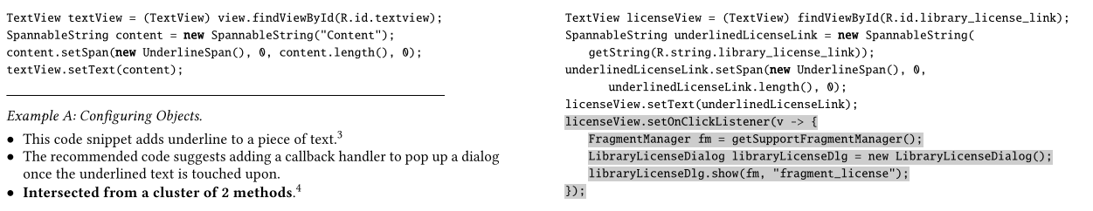
Evaluation
Recommendation Quality on Full Code Snippets
Configuring Objects
the recommended code suggests additional configurations on objects that are already appearing in the query code. Examples include adding callback handlers, and setting additional flags and properties of an existing object.

Slide 22
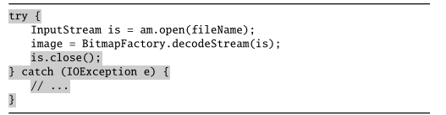
Evaluation
Recommendation Quality on Full Code Snippets
Error Checking and Handling
the recommended code adds null checks and other checks before using an object, or adds a try-catch block that guards the original code snippet.

Slide 23
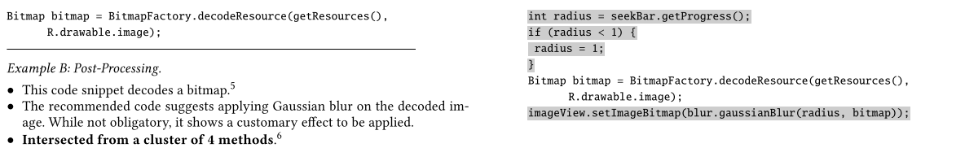
Evaluation
Recommendation Quality on Full Code Snippets
Post-processing
The recommended code extends the query code to perform some common operations on the objects or values computed by the query code. For example, recommended code can show API methods that are commonly called.

Slide 24
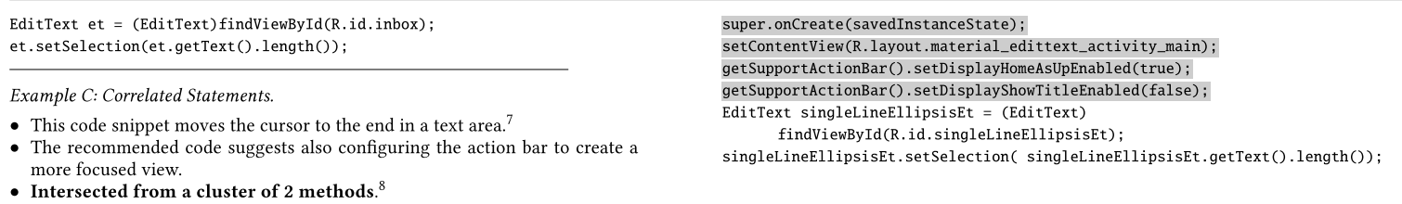
Evaluation
Recommendation Quality on Full Code Snippets
Correlated Statements
The recommended code adds statements that do not affect the original functionalities of the query code, but rather suggests related statements that commonly appear alongside the query code.
Notes:
the recommended code also configures the Android Support Action Bar to show the home button and hide the activity title in order to create a more focused view. These

Slide 25
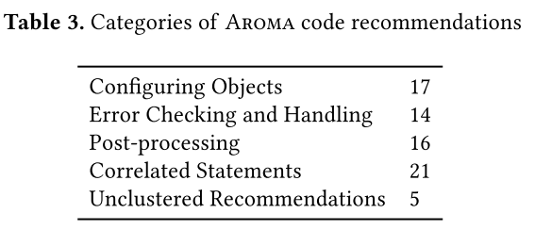
Evaluation
Recommendation Quality on Full Code Snippets
Unclustered Recommendations
In rare cases, the query code snippet could match method bodies that are mostly different from each other. This results in clusters of size 1.
In these cases, Aroma performs no intersection and recommends the full method bodies without any pruning
The first four categories all can be useful to programmers in different ways
For 59 out of the 64 query code snippets (92%), Aroma generated at least one useful recommended snippet that falls in the first four categories.
Notes:
For recommendations that belong to multiple categories, we counted them for each of the categories.

Slide 26
Evaluation
Comparison with Pattern-Oriented Code Completion
Dataset:
We took the dataset of 15 Android API usage patterns manually curated from Stack Overflow posts and Android documentation by the authors of BigGroum [Mover et al. 2018].
Results:
Among these 15 snippets, 11 were found in BigGroum mining results.
For 14 out of 15 patterns, Aroma recommended code containing the original usage patterns, i.e. they are exact recommendations
Advantage
It could recommend code snippets that do not correspond to any previously mined pattern by BigGroum.
It could recommend code which may not contain any API usage

Slide 27
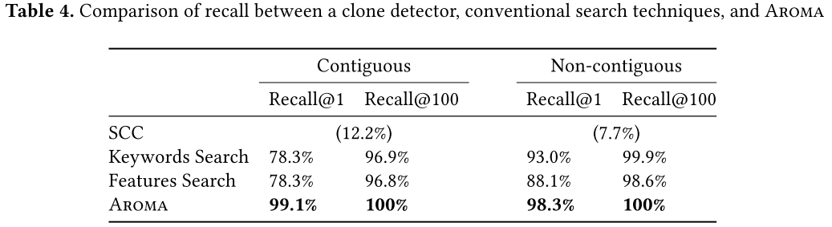
Evaluation of Search Recall
Recall in Prune and Rerank Phase
Notes:
Recall@100 because the first 100 methods in the reranked list are used in the clustering phase to create recommended code.
instead of creating a binary vector in the featurization stage, we created a normalized TF-IDF vector
another conventional code search technique by simply treating a method body as a bag of words and using the standard TF-IDF technique for retrieval

Slide 28
Thanks !

